Slide 1

High Entropy Alloys: Transition Metal Doping of Ba(Fe)₂As₂
Yash Anand¹, Prathum Saraf¹, Dan Sokratov¹,Ram Kumar¹ Johnpierre Paglione¹
¹Quantum Materials Center, Physics Department, University Of Maryland

Slide 2
Overview
Background
Methodology
Data Analysis
Conclusion
Reference

Slide 3
Overview
Background
High Entropy Alloys
Non-Fermi Liquid Behavior
Motivation
Methodology
Data Analysis
Conclusion
Reference

Slide 4
High Entropy Alloys (HEA)
Definition:
HEA are defined as materials with 4-5 equiatomic elements
This allows disorder to not be a weak perturbation but the leading energy scale in synthesis
4 Core effects:
High Entropy Effect:
In Gibbs Free Energy equation, entropy wins leading to the phases becoming highly competitive for equilibrium state and more stable especially at high temperatures
Severe Lattice Distortion Effect:
Due to the mix of multi-principal elements lattice gets deformed, leading to some of the interesting physical properties
Sluggish Diffusion Effect:
Due to the multiple principal elements, the lattice potential energy varies from one point to another, leading to different atomic diffusions
Cocktail Effect:
The microstructures and properties are determined by not only the composite materials, but also the different separate lattices

Slide 5
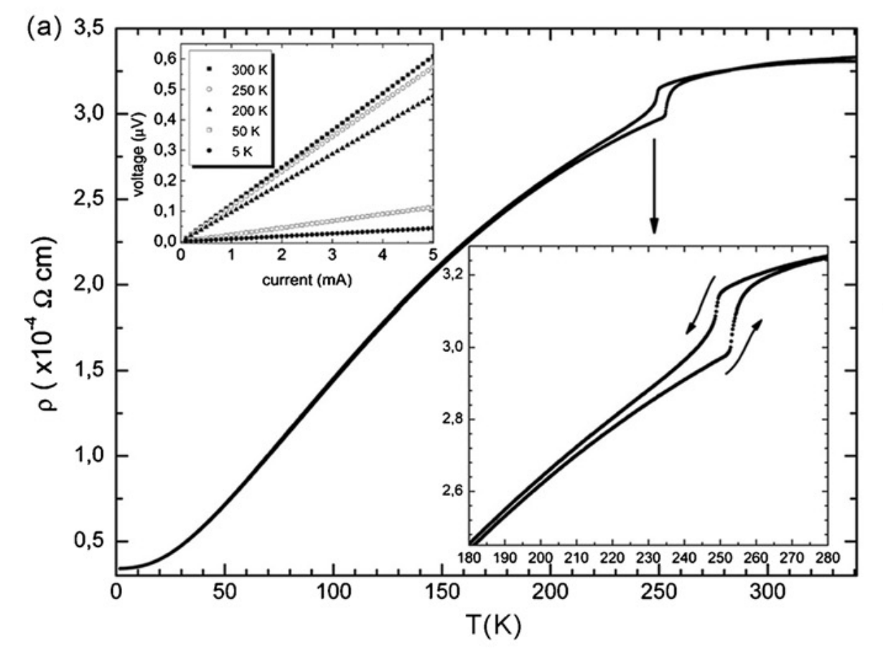
Fermi Liquid Behavior
Perturbatively adding interaction to the non-interacting fermi gas model
Electrons behave like quasiparticles
At low temperatures the resistivity follows a quadratic rule
Most metals at low temperatures
https://doi.org/10.1016/j.jallcom.2006.09.157

Slide 6
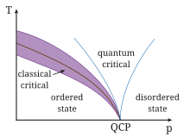
Non-Fermi Liquid Behavior
Metals where the interactions between electrons can't be treated as a small perturbation
One place where we see NFL is near quantum critical points (smooth phase transition at absolute zero due to quantum fluctuations)
One key identifier of NFL is linear temperature dependence of resistance
https://en.wikipedia.org/wiki/File:QuantumPhaseTransition.svg

Slide 7
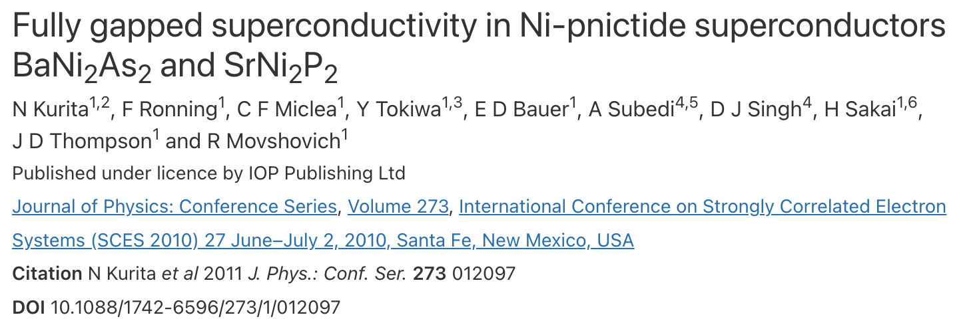
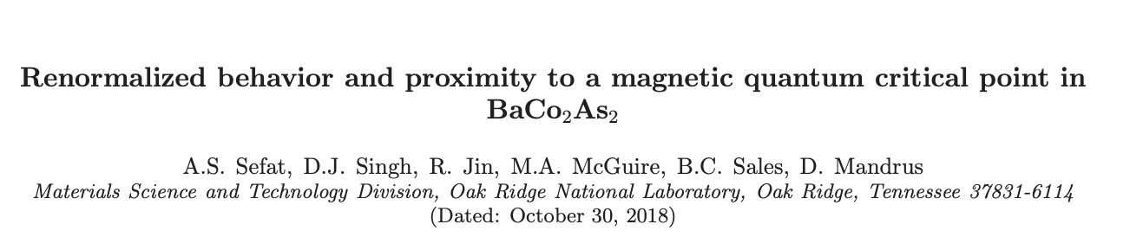
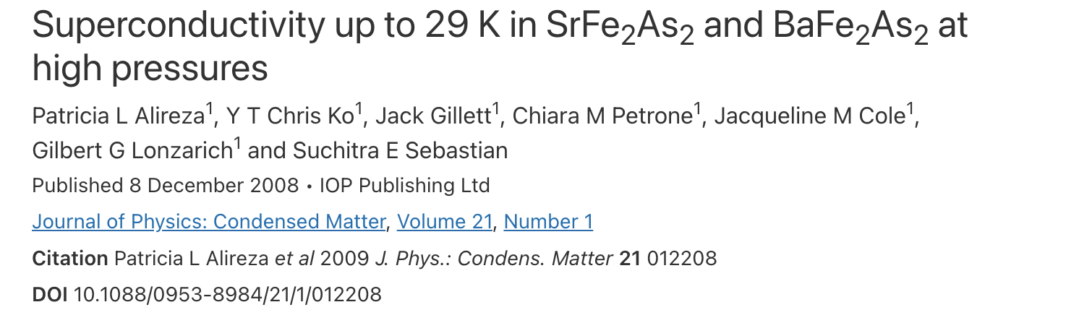
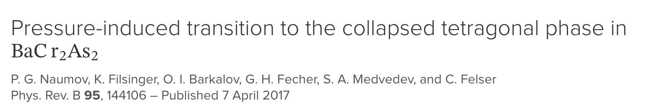
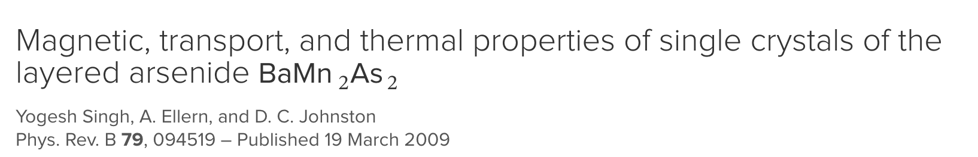
Ba(TM)₂As₂ Parent Compound

Slide 8
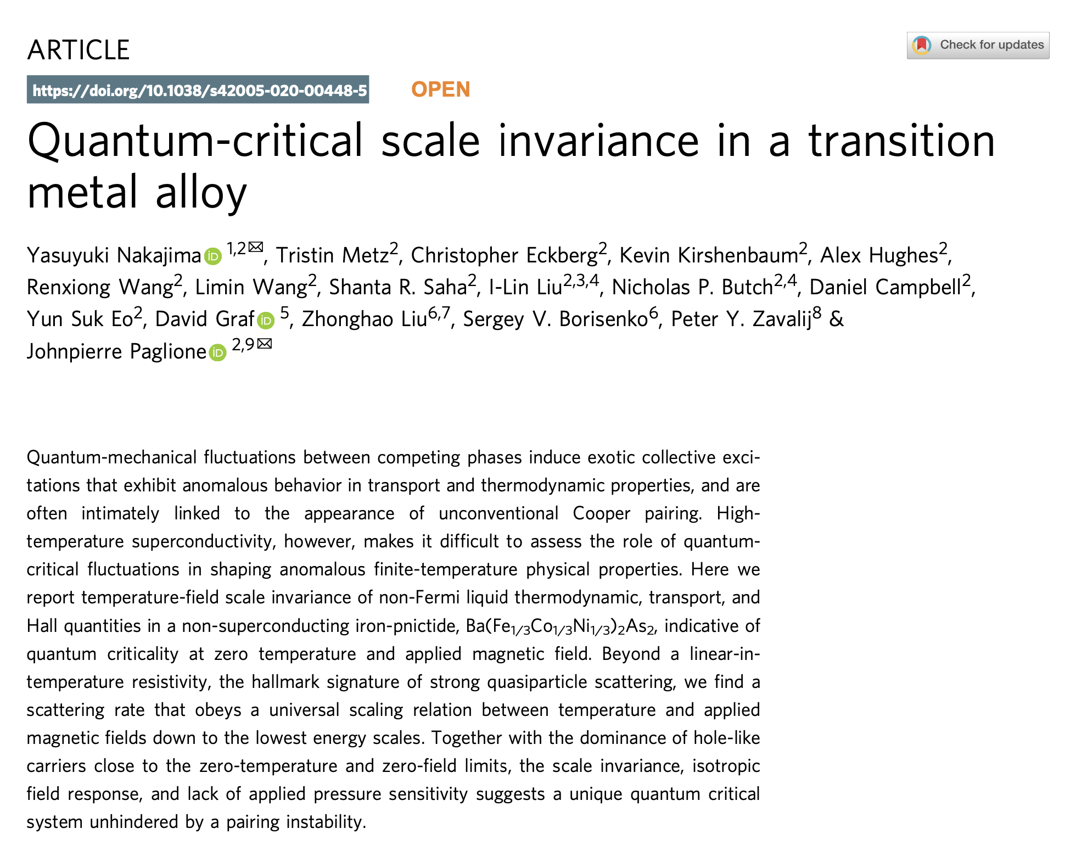
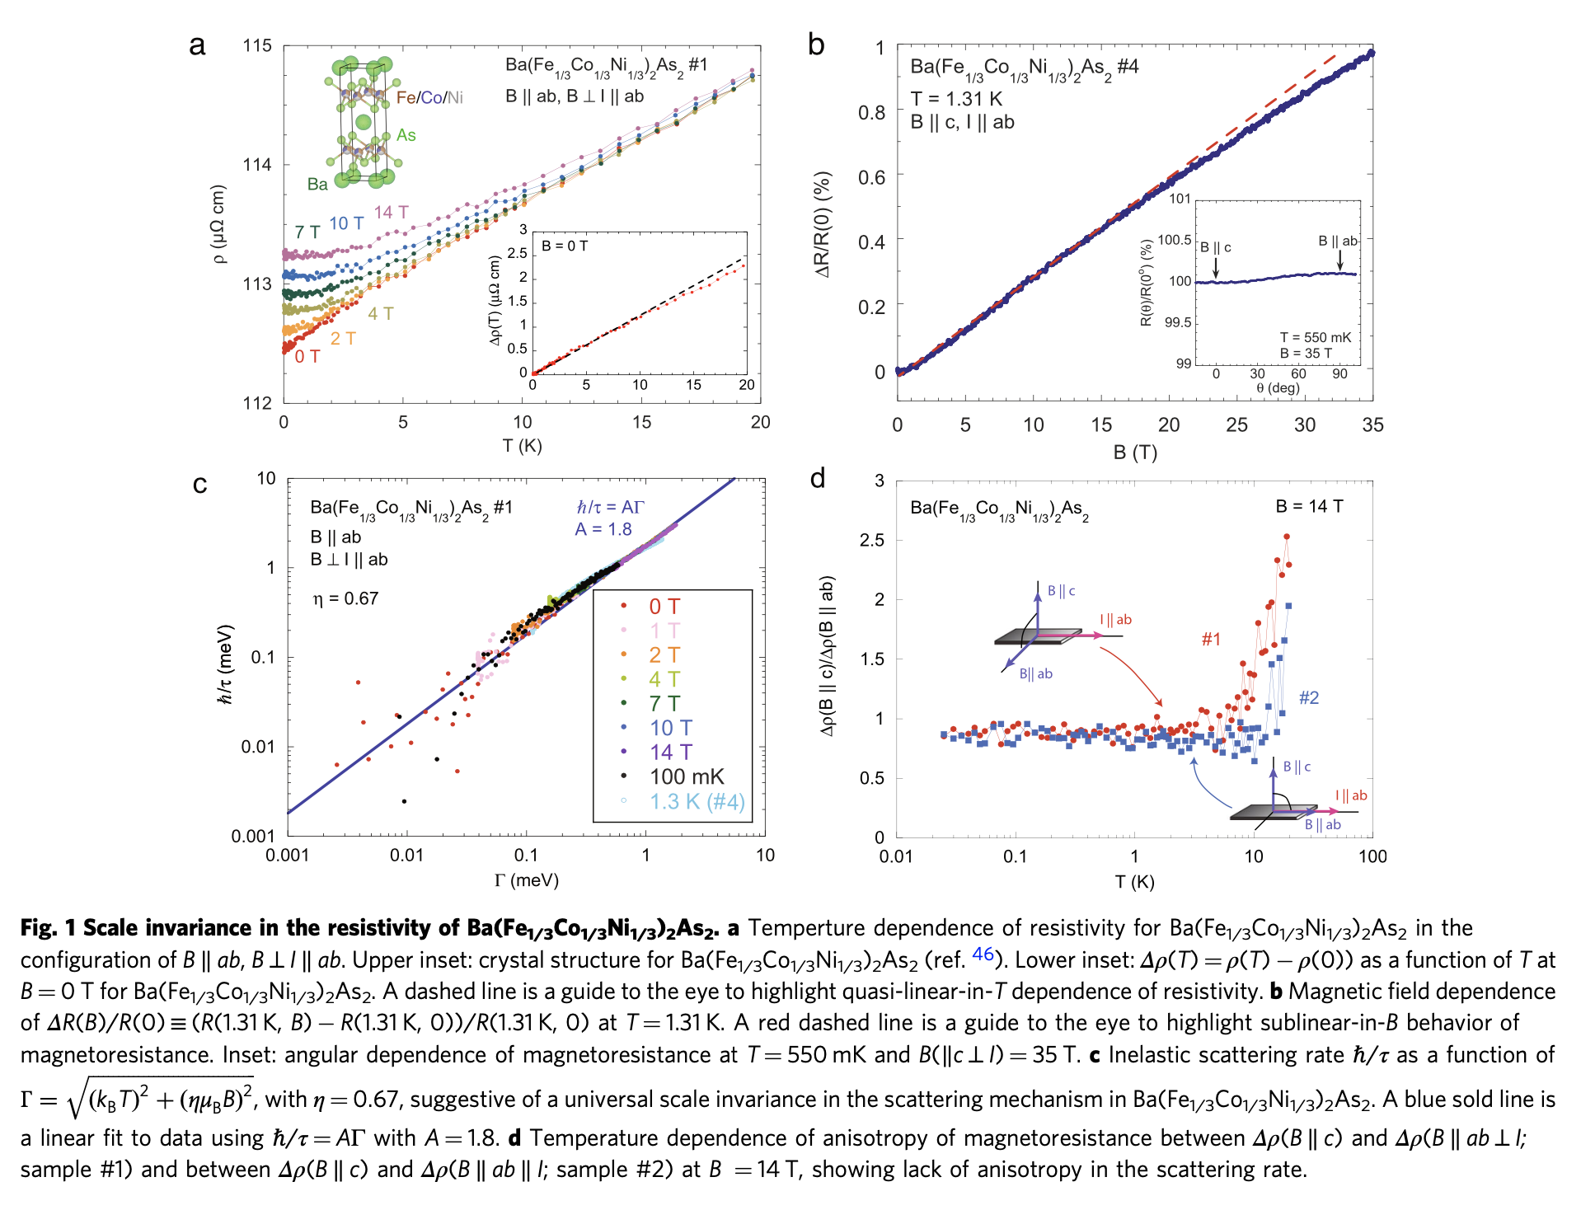
Past Results

Slide 9
Overview
Background
Methodology
Synthesis
Spectroscopy
Data Analysis
Conclusion
Reference

Slide 10
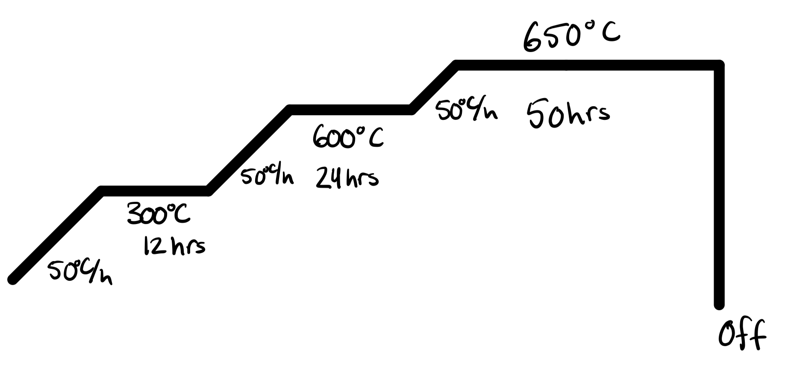
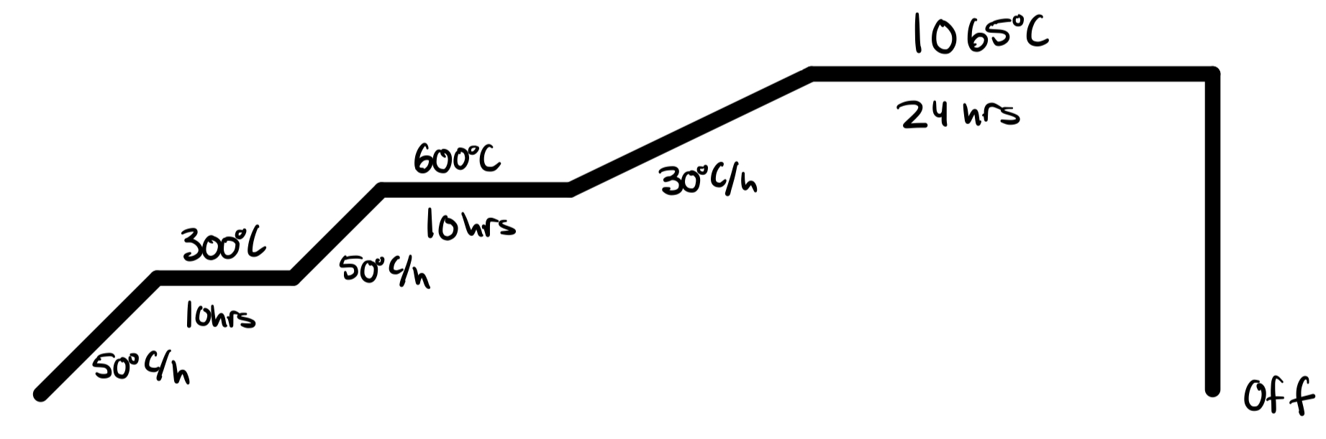
Synthesis: Transition Metal Arsenides
Fig (a)
Fig (b)
Stoichiometric ratio of 1.01:1 TM:As in Aluminum crucible
Two different growth profiles:
Cr and Mn flux profile is seen in figure (a)
Fe and Co flux profile is seen in figure (b)

Slide 11
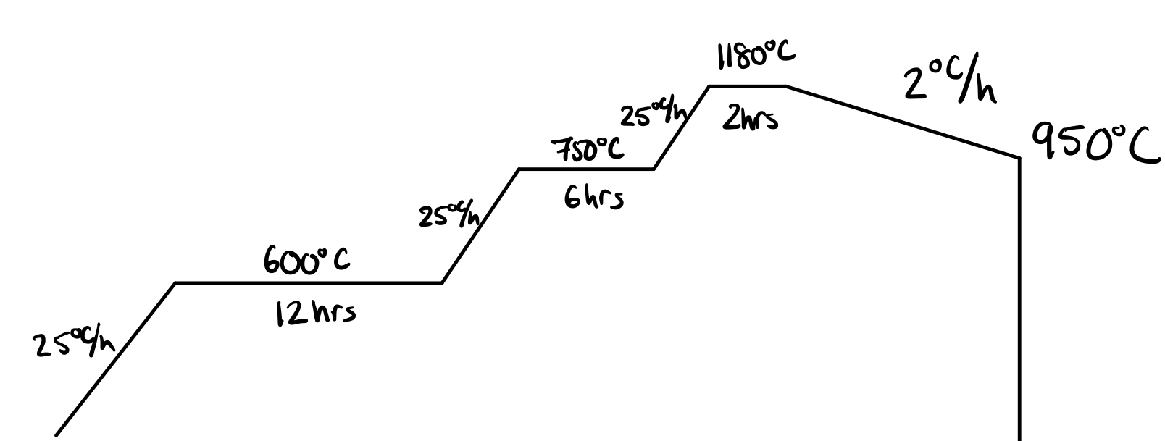
Synthesis: Quadra- and Penta-Doped Sample
We used an equiatomic ratio of the As-Flux with Ba
Used the following profile for the sample growth

Slide 12
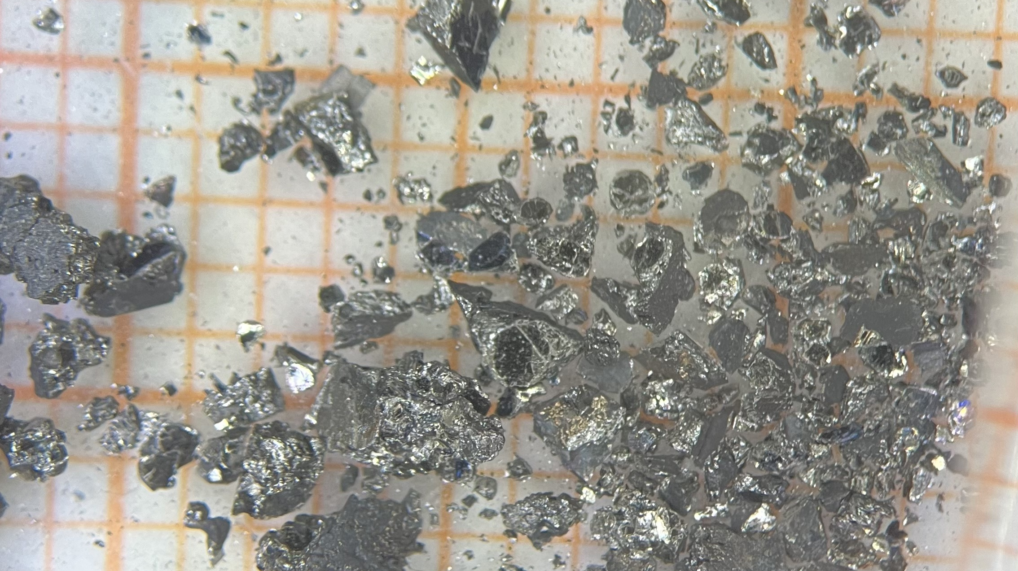
Synthesis: Quadra-Doped Sample Ba(CrFeCoNi)₂As₂

Slide 13
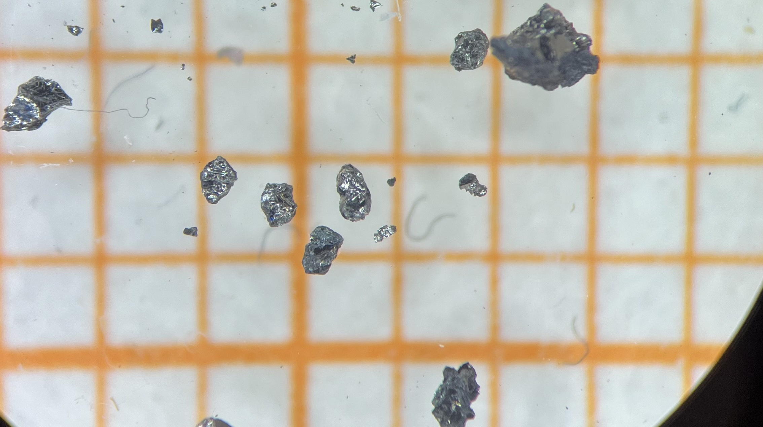
Synthesis: Penta-Doped Sample Ba(CrMnFeCoNi)₂As₂

Slide 14
Spectroscopy: X-Ray Diffraction (XRD)
XRD:
Powder the crystals into fine grains
Uses monochromatic X-rays
Using X-ray diffraction peaks we can determine if the sample is the desired material
Very useful for characterizing and confirming As flux
Issues:
Does not tell you of the elemental composition of sample
Needs the sample to be previously grown/studied
Powder XRD destroys the sample

Slide 15
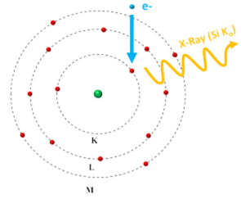
Spectroscopy: Energy-Dispersive X-ray Spectroscopy (EDS)
EDS:
Bombards sample with electrons to get characteristic x-rays of the elements in the sample
Uses full single crystal, so sample isn’t destroyed
Gives the elemental composition of the sample
Issues:
Doesn’t tell us about the crystal structure
https://nano.oxinst.com/campaigns/what-is-eds/edx

Slide 16
Spectroscopy: X-Ray Fluorescence (XRF)
XRF:
Bombards sample with x-rays to excite inner level electrons, creating vacancies that get filled by outer shell electrons releasing characteristic x-rays
Uses polychromatic x-rays
Uses single crystal
Gives the elemental composition of the sample
Issues:
Doesn’t tell us the crystal structure
Difference between XRF and EDS:
XRFs can go deeper into the sample while EDS looks at the surface of the sample

Slide 17
Overview
Background
Methodology
Data Analysis
Spectroscopy
Transport
Magnetization
Conclusion
Reference

Slide 18
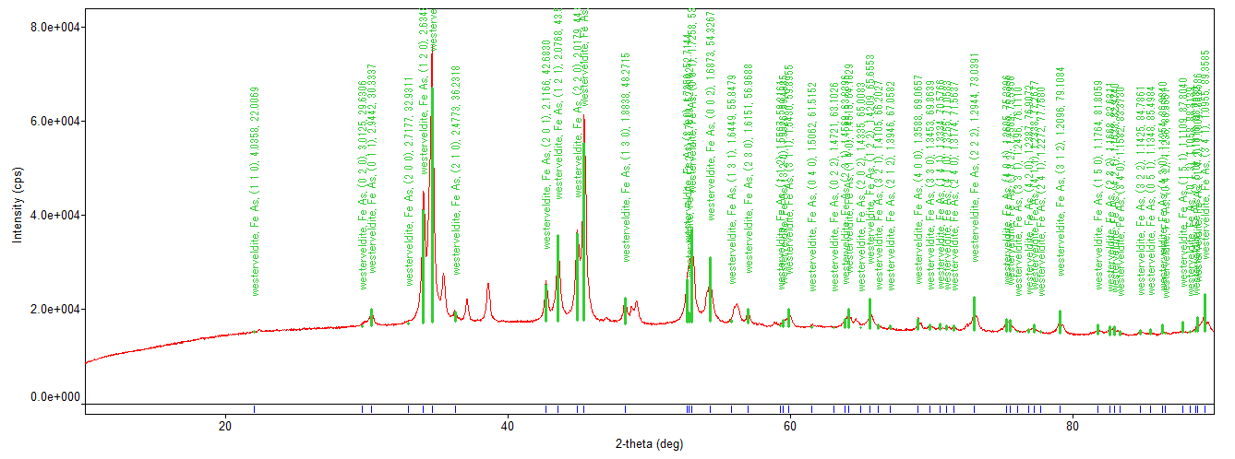
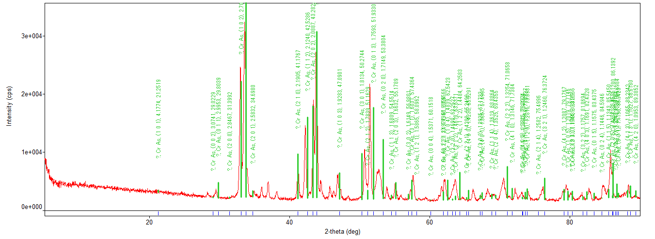
XRD: Transition Metal Arsenide
FeAs flux
CrAs flux

Slide 19
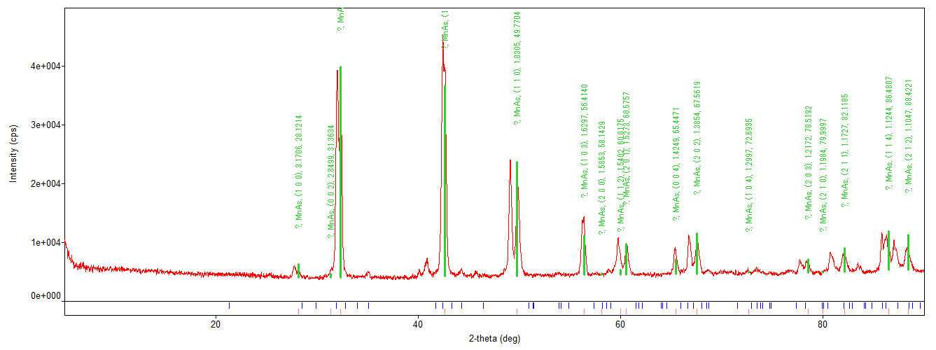
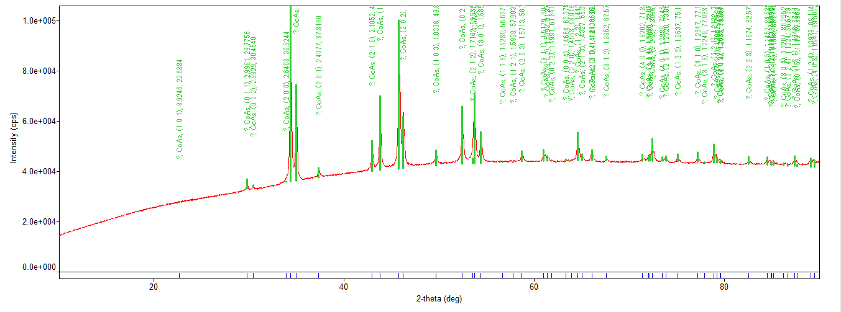
XRD: Transition Metal Arsenide
MnAs flux
CoAs flux

Slide 20
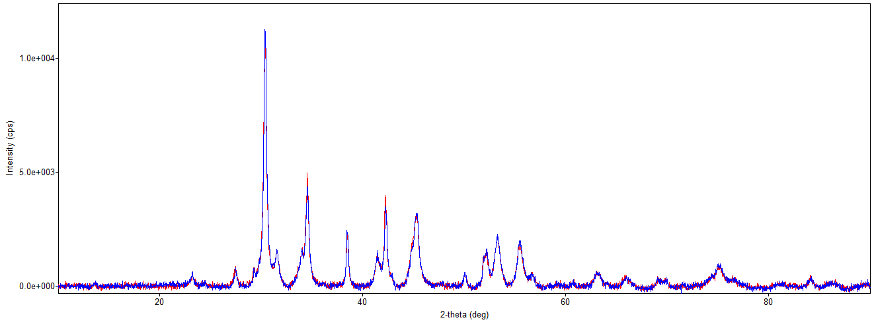
XRD: Penta-Doped Air Sensitivity

Slide 21
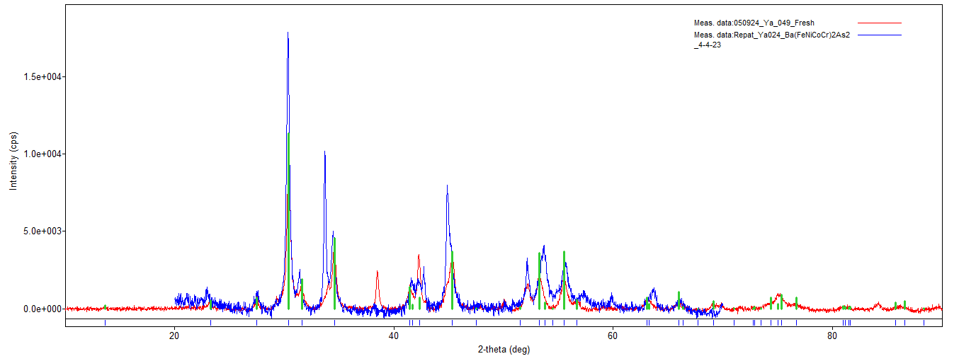
XRD: Quadra and Penta Doping

Slide 22
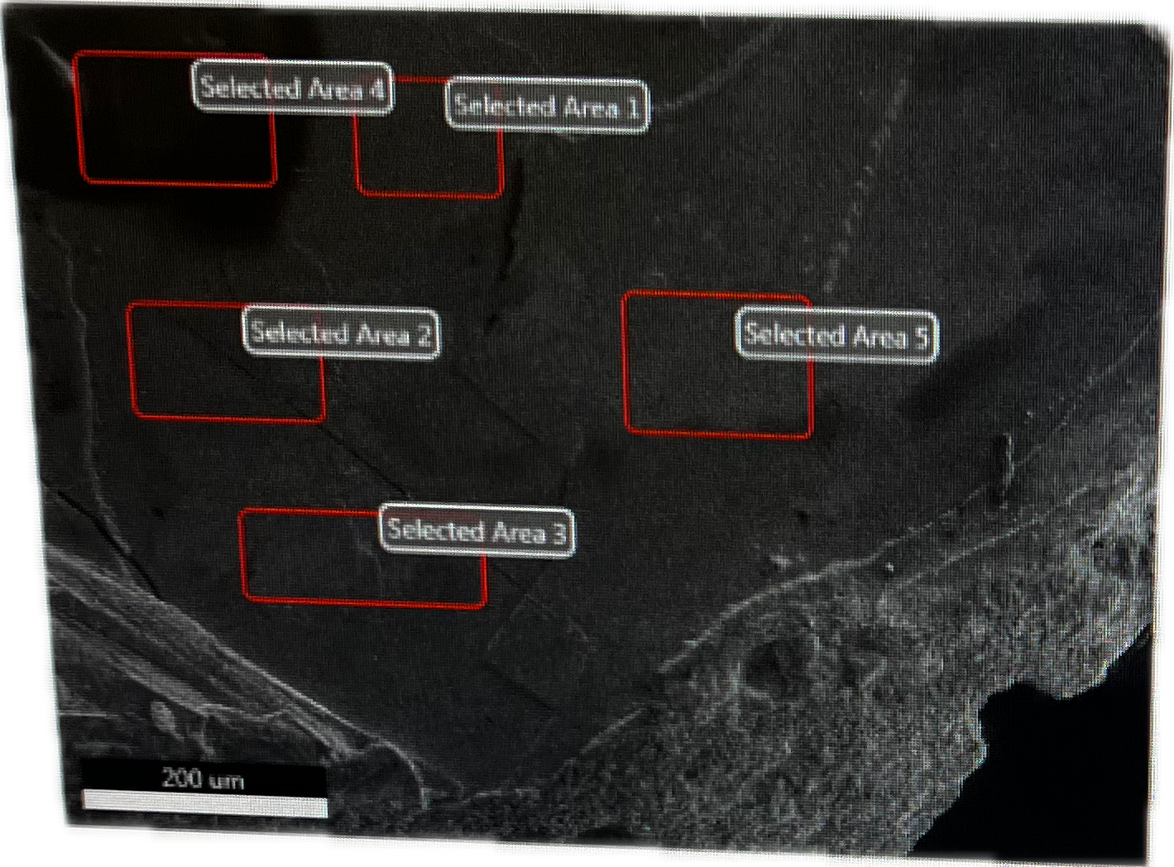
EDS: Quadra Doping
Element | Weight % | Atomic %
As | 38.97 | 40.60
Ba | 30.14 | 17.13
Cr | 3.05 | 4.58
Fe | 10.38 | 14.51
Co | 8.09 | 10.72
Ni | 9.36 | 12.45

Slide 23
XRF: Penta Doping
Element | Weight % | Atomic %
As | 22.606 | 25.059
Ba | 45.305 | 27.399
Cr | 5.488 | 8.766
Mn | 5.424 | 8.200
Fe | 8.952 | 13.313
Co | 6.011 | 8.471
Ni | 6.214 | 8.793

Slide 24
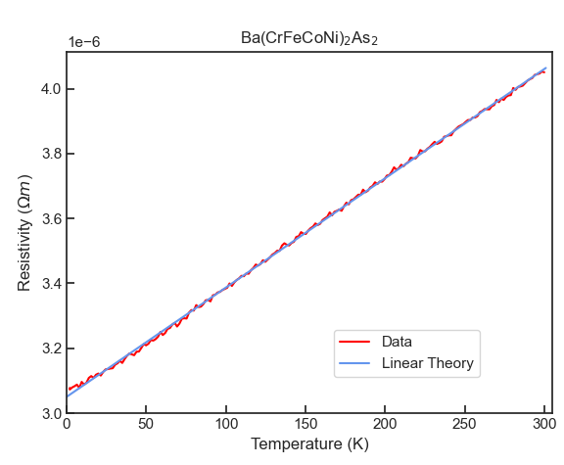
Transport: Quadra Doped
Linear in temperature resistivity
We see deviation at around 5K
Linear fit: R = 3.3(7)*10⁻⁹*T+3.0(5)*10⁻⁶

Slide 25
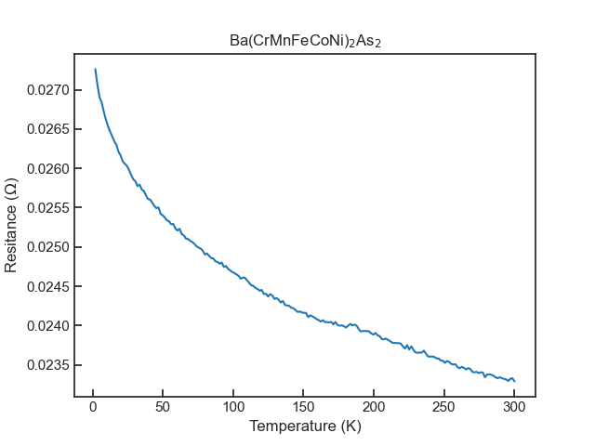
Transport: Penta Doped
Resistance has an inverse relation to temperature
We see linear behavior between 200 and 300 K

Slide 26
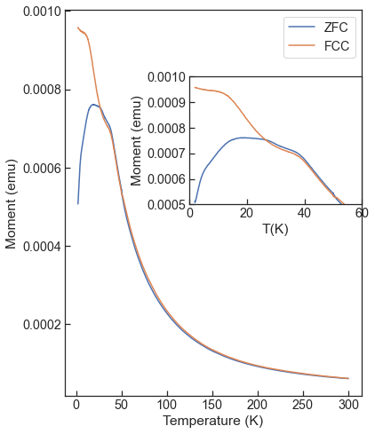
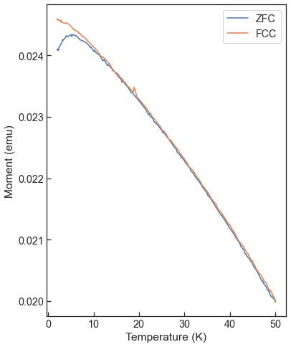
Magnetization: Penta Doped
We see about two transitions:
40 K in both ZFC and FCC
30 K which leads to bifurcation
We see bifurcation even at 7T
At 7T all the transitions seem to merge at 5K

Slide 27
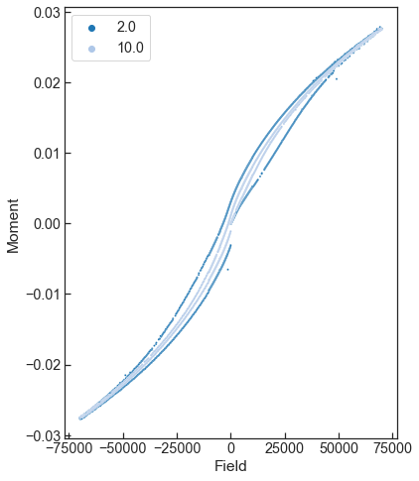
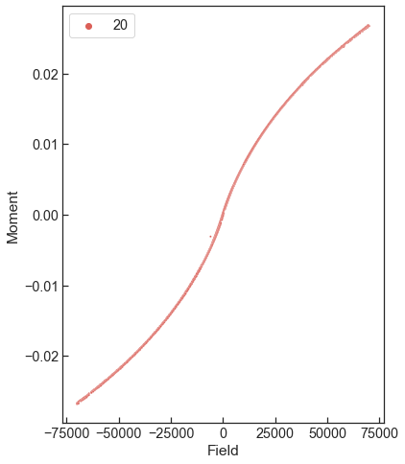
Magnetization: Penta Doped
Seems ferrimagnetic rather than ferromagnetic since there is no saturation
At 20K, the hysteresis goes away, indicating an antiferromagnetic transition

Slide 28
Overview
Background
Methodology
Data Analysis
Conclusion
Reference

Slide 29
Conclusion
We have seen non-Fermi liquid behavior in the quadra doped sample
Adding 5 elements makes the material insulating
There are interesting magnetic properties that arise from the penta doping
Hinting at spin glass due to the bifurcation in ZFC and FCC
Hysteretic behavior hinting towards Ferrimagnetic ordering

Slide 30
Overview
Background
Methodology
Data Analysis
Conclusion
Reference

Slide 31
References
A. J. Schofield (1999) Non-Fermi liquids, Contemporary Physics, 40:2, 95-115, DOI: 10.1080/001075199181602
Nakajima, Y., Metz, T., Eckberg, C. et al. Quantum-critical scale invariance in a transition metal alloy. Commun Phys 3, 181 (2020). https://doi.org/10.1038/s42005-020-00448-5
Sales, B.C., Jin, K., Bei, H. et al. Quantum critical behavior in the asymptotic limit of high disorder in the medium entropy alloy NiCoCr0.8 . npj Quant Mater 2, 33 (2017). https://doi.org/10.1038/s41535-017-0042-7
Solveig S. Aamlid, Mohamed Oudah, Jörg Rottler, and Alannah M. Hallas Journal of the American Chemical Society 2023 145 (11), 5991-6006 DOI: 10.1021/jacs.2c11608

